Slide 1
Interrupt in 8086

Slide 2
An interrupt is a condition that halts the microprocessor temporarily to work on a different task and then returns to its previous task.
An interrupt is an event or signal that requests the CPU’s attention
This halt allows peripheral devices to access the microprocessor.
Whenever an interrupt occurs, the processor completes the current instruction and starts the implementation of an Interrupt Service Routine (ISR) or Interrupt Handler
ISR is a program that tells the processor what to do when the interrupt occurs
After the ISR execution, control returns to the main routine where it was interrupted

Slide 3
In the 8086 microprocessor following tasks are performed when the microprocessor encounters an interrupt:
The value of the flag register is pushed into the stack. It means that first, the value of SP (Stack Pointer) is decremented by two then the value of the flag register is pushed to the memory address of the stack segment.
The value of starting memory address of CS (Code Segment) is pushed into the stack.
The value of IP (Instruction Pointer) is pushed into the stack.
IP is loaded from word location (Interrupt type) * 04 (indirect far jmp)
CS is loaded from the following word location.
Interrupt, and Trap flags are reset to 0.

Slide 4
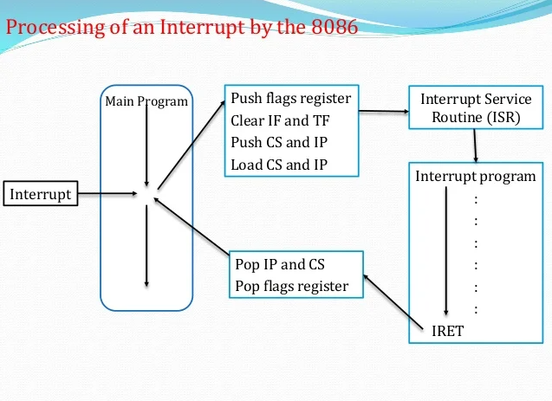

Slide 5
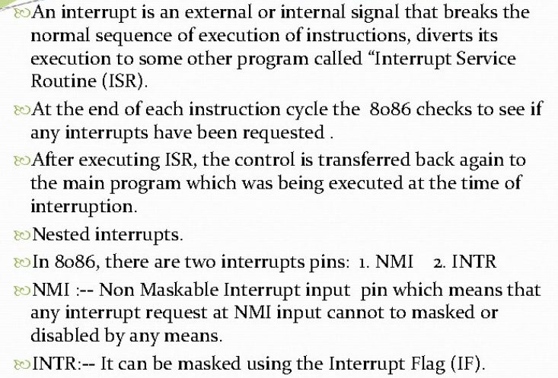

Slide 6
The different types of interrupts present in the 8086 microprocessor are given by
1. Hardware Interrupts – Hardware interrupts are those interrupts that are caused by any peripheral device by sending a signal through a specified pin to the microprocessor. There are two hardware interrupts in the 8086 microprocessor. They are:
NMI (Non-Maskable Interrupt): It is a single pin non-maskable hardware interrupt that cannot be disabled. It is the highest priority interrupt in the 8086 microprocessor. After its execution, this interrupt generates a TYPE 2 interrupt. IP is loaded from word location 00008 H, and CS is loaded from the word location 0000A H.

Slide 7
B. INTR (Interrupt Request): It provides a single interrupt request and is activated by the I/O port. This interrupt can be masked or delayed. It is a level-triggered interrupt. It can receive any interrupt type, so the value of IP and CS will change on the interrupt type received.

Slide 8
2. Software Interrupts – These are instructions inserted within the program to generate interrupts. There are 256 software interrupts in the 8086 microprocessor.
The instructions are of the format INT type, where the type ranges from 00 to FF. The starting address ranges from 00000 H to 003FF H.
These are 2-byte instructions. IP is loaded from type * 04 H, and CS is loaded from the following address given by (type * 04) + 02 H.
Some important software interrupts are:
TYPE 0 corresponds to division by zero(0).
TYPE 1 is used for single-step execution for debugging the program.
TYPE 2 represents NMI and is used in power failure conditions.
TYPE 3 represents a break-point interrupt.
TYPE 4 is the overflow interrupt.

Slide 9
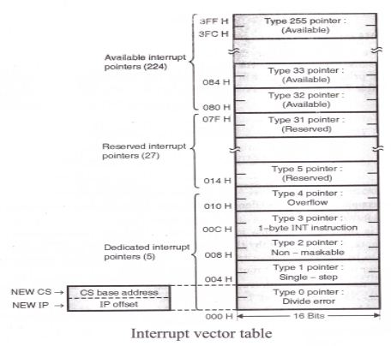
Interrupt Vector Table (IVT):

Slide 10
The interrupt vector (or interrupt pointer) table is the link between an interrupt type code and the procedure that has been designated to service interrupts associated with that code. 8086 supports total 256 types i.e. 00H to FFH.
For each type it has to reserve four bytes i.e. double word. This double word pointer contains the address of the procedure that is to service interrupts of that type
The higher addressed word of the pointer contains the base address of the segment containing the procedure. This base address of the segment is normally referred as NEW CS.

Slide 11
The lower addressed word contains the procedure’s offset from the beginning of the segment. This offset is normally referred as NEW IP
Thus NEW CS: NEW IP provides NEW physical address from where user ISR routine will start.
As for each type, four bytes (2 for NEW CS and 2 for NEW IP) are required; therefore interrupt pointer table occupies up to the first 1k bytes (i.e. 256 x 4 = 1024 bytes) of low memory.

Slide 12
The total interrupt vector table is divided into three groups namely,
A. Dedicated interrupts (INT 0…..INT 4)
B. Reserved interrupts (INT 5…..INT 31)
C. Available interrupts (INT 32…..INT 225)

Slide 13
A. Dedicated interrupts (INT 0…..INT 4):
1. INT 0 (Divide Error)-
This interrupt occurs whenever there is division error i.e. when the result of a division is too large to be stored. This condition normally occurs when the divisor is very small as compared to the dividend or the divisor is zero.
Its ISR address is stored at location 0 x 4 = 00000H in the IVT.
2. INT 1 (Single Step)-
The microprocessor executes this interrupt after every instruction if the TF is set.
It puts microprocessor in single stepping mode i.e. the microprocessor pauses after executing every instruction. This is very useful during debugging.
Its ISR generally displays contents of all registers. Its ISR address is stored at location 1 x 4 = 00004H in the IVT.

Slide 14
INT 2 (Non mask-able Interrupt)-
The microprocessor executes this ISR in response to an interrupt on the NMI (Non mask-able Interrupt) line.
Its ISR address is stored at location 2 x 4 = 00008H in the IVT.
INT 3 (Breakpoint Interrupt)-
This interrupt is used to cause breakpoints in the program. It is caused by writing the instruction INT 03H or simply INT.
It is useful in debugging large programs where single stepping is efficient.
Its ISR is used to display the contents of all registers on the screen. Its ISR address is stored at location 3 x 4 = 0000CH in the IVT.
INT 4 (Overflow Interrupt)-
This interrupt occurs if the overflow flag is set and the microprocessor executes the INTO (Interrupt on Overflow) instruction.
It is used to detect overflow error in signed arithmetic operations.
Its ISR address is stored at location 4 x 4 = 00010H in the IVT.

Slide 15
B. Reserved interrupts (INT 5…..INT 31):
These levels are reserved by Intel to be used in higher processors like 80386, Pentium etc. They are not available to the user.

Slide 16
c. Available interrupts (INT 32…..INT 225):
These are user defined, software interrupts.
ISRs for these interrupts are written by the users to service various user defined conditions.
These interrupts are invoked by writing the instruction INT n. Its ISR address is obtained by the microprocessor from location n x 4 in the IVT.

Slide 17
Hardware Interrupts:
NMI (Non mask-able interrupt)-
This is a non-mask-able, edge triggered, high priority interrupt.
On receiving an interrupt on NMI line, the microprocessor executes INT
Microprocessor obtains the ISR address from location 2 x 4 = 00008H from the IVT.
It reads 4 locations starting from this address to get the values for IP and CS to execute the ISR.

Slide 18
This is a mask-able, level triggered, low priority interrupt.
On receiving an interrupt on INTR line, the microprocessor executes 2 INTA¯ pulses.
1st INTA pulse – The interrupting device calculates (prepares to send) the vector number.
2nd INTA pulse – The interrupting device sends the vector number ‘N’ to the microprocessor.
Now microprocessor multiplies N x 4 and goes to the corresponding location in the IVT to obtain the ISR address. INTR is a mask-able interrupt.
It is masked by making IF = 0 by software through CLI instruction.
It is unmasked by making IF = 1 by software through STI instruction.

